Slide 1
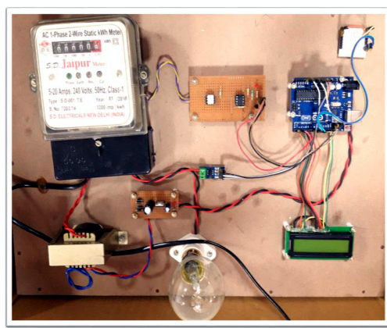
IoT Based Cloud-Enabled
Smart Electricity
Management System
A presentation-ready overview of the project, methodology, hardware architecture, cloud visualization, and results.
Energy Metering • IoT • Cloud • ThingSpeak
Presented at SSIC-2019 • Springer proceedings context

Slide 2
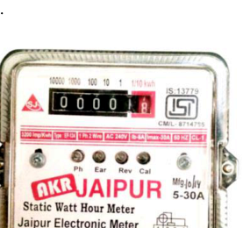
Problem: manual electricity monitoring is slow
Traditional meter reading creates delay, effort, and reduced transparency for users.
Why a smarter system is needed
01
Manual visits
Users must physically check meters or wait for operator readings.
02
Billing uncertainty
Limited visibility into what was consumed and how cost was calculated.
03
No real-time awareness
Consumption patterns are not visible until after usage has already happened.
Move from meter reading
to connected monitoring
04
Energy efficiency gap
The project digitizes consumption capture and sends readings to the cloud for remote access and visualization.
Hard to detect waste, misuse, abnormal loads, or device-level consumption.
IoT Smart Electricity Management System
02

Slide 3
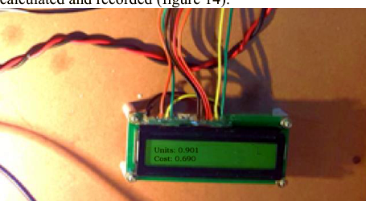
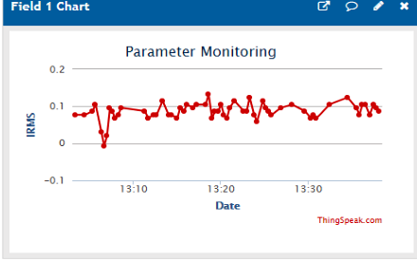
System concept: meter data becomes cloud insight
A connected measurement chain captures readings, processes them, and visualizes them online.
Electric
Meter
Current
Sensor
Arduino
Controller
Wi‑Fi
Module
ThingSpeak
Cloud
LCD display gives local visibility while cloud graphs enable remote monitoring.
Outputs: units consumed, IRMS, calculated cost, and usage trends.
IoT Smart Electricity Management System
03

Slide 4
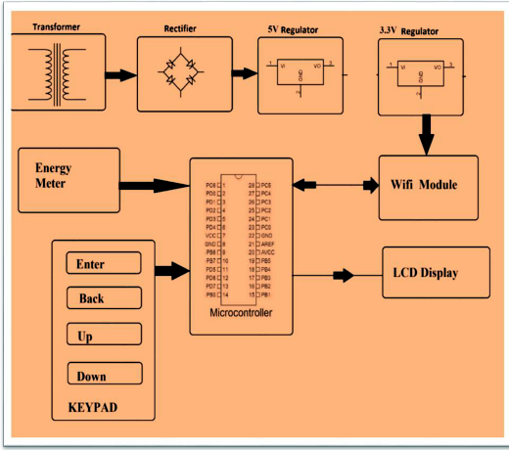
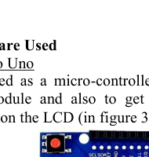
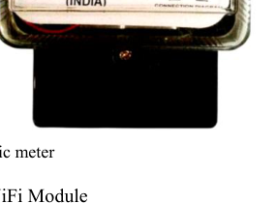
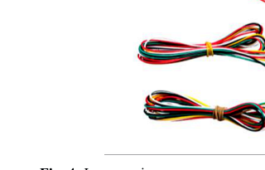
Prototype architecture
Core components used for E-monitoring of energy meter readings.
The controller collects meter pulses, calculates readings, displays them locally, and transmits data through Wi‑Fi to the cloud.
Controller
Arduino Uno processes sensor readings and controls display/network flow.
Connectivity
ESP8266 Wi‑Fi module enables IoT communication with the cloud.
Cloud layer
ThingSpeak stores and visualizes readings as live charts.
Local output
LCD shows units and cost for immediate user feedback.
Architecture diagram from the project paper
IoT Smart Electricity Management System
04

Slide 5
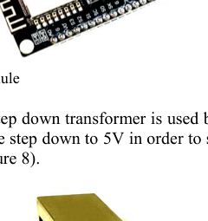
Hardware and software stack
The implementation combines metering hardware, embedded control, connectivity, and cloud analytics.
Hardware
Software / platform
Arduino Uno
ESP8266 Wi‑Fi module
LCD panel
Electric meter
Transformer
Bulb/load, jumper wires, breadboard, resistors
Arduino IDE for programming
ThingSpeak API for visualization
ThingSpeak cloud services
Linux/Ubuntu test environment
Wi‑Fi local network
Prototype board with meter, Arduino, LCD, load, and wiring
IoT Smart Electricity Management System
05

Slide 6
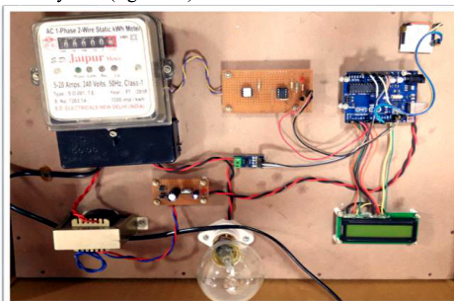
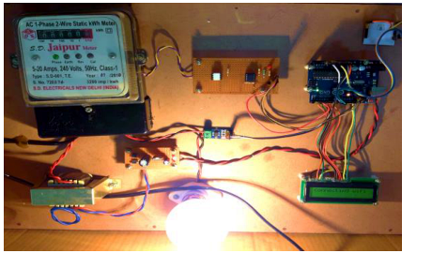
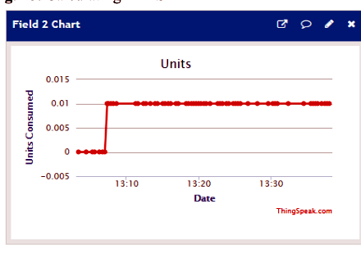
Methodology
From circuit assembly to cloud visualization and system testing.
01
02
03
04
05
Understand Arduino and meter operation
Collect components and connect circuit
Program Arduino and integrate Wi‑Fi module
Send readings to ThingSpeak cloud
Visualize, test, and validate readings
Prototype → Wi‑Fi connected load → cloud reading visualization
IoT Smart Electricity Management System
06

Slide 7
Results: lower consumption and cloud visibility
The project reported successful unit calculation, Wi‑Fi transmission, and ThingSpeak analysis.
Reported comparison from project Table 1
Cloud dashboard captures IRMS and units while LCD provides on-device feedback.
IoT Smart Electricity Management System
07

Slide 8
Conclusion and presentation certificate
A smart meter prototype that improves access, accountability, and reliability.
Key takeaways
Remote access
Users can monitor readings through cloud visualization.
Better transparency
Units and cost are visible instead of hidden in delayed billing.
Efficient monitoring
IoT reduces manual effort and improves responsiveness.
Extendable design
Applicable to homes, industries, and maintenance monitoring.
IoT Smart Electricity Management System
08

